Slide 1
Role kontejnerizace v moderním IT
Tomáš Michaeli
Manager, Solution Engineering - Czech & Middle Europe
tmichaeli@vmware.com / +420 724 828 340

Slide 2

Úvod
Modelový zákazník
Modernizace privátního cloudu pomocí kontejnerizace
Benefity modernizace privátního cloudu
Dotazy?

Slide 3
Obchodní rozhodnutí v současném kontextu
Workloadů je poháňané VMware¹
85M
Obchodné priority – tůst, rychlá transformace na základě Dat, Analytiky a Bezpečnosti
Priority provozu – minimalizace bezpečnostních rizik a výpadků, udržení budget, lidi a využití stávajících investic
Dilema: “Refactor a Transform” nebo “Modernizace”?
Jak transformovat business … ale využít stávající investice, udržení provozu a minimalizace výpadků nebo bezpečnostních rizik
1. 85M workloads
Notes:
GCVE inovace, když se podívame zpátky
Požadavky: cost, securita, dostupnost
Každá společnost řeší Cloudovou transformaci a silu AI
Když se to podíváme optikou podníkového IT, ve vSphere dnes běží majoritní část business krytických aplikací on-prem
Podle našeho průzkumu to je 85M aplikací
Tyto společnosti reší dilemma jak dál – Lift & Shift versus Refactor & Transform každý den
Na jedné straně: obchodní priorita rustu, rozhodování na základě datové analýzy
Na druhé straně: IT operation – cena, minimalizace výpadků a maximální využití stávající investicí
Máme investovat do Refactor & Transform
Nebo udělat Lift & Shift a věnovat se transformaci později
Balancovaní mezi těmito směry dvěma přináší kompromisy
Tady vstupuje GCVE do hry
When you put it in the context of enterprises, vSphere powers the majority of compute workloads in on-prem environments - and there are 85M vsphere-based workloads.
These businesses deal with the “Lift and Shift” vs. “Refactor and Transform” dilemma every day
On one hand is the business priority of growth and transforming the business as fast as possible leveraging the best of data, analytics, security, AI/ML services
On the other hand, IT and operations leaders need to prioritize cost optimization, minimize risk, downtime and maximize the use of existing investments they have made.
So the dilemma this creates is how can an organization rapidly transform while minimizing IT risk, change management and expenses? Should we invest in “refactor and transform” or should we “lift and shift” quickly and deal with the transformation later? Balancing the two often requires a tradeoff, forcing leaders to choose between Lift and Shift (low risk/effort, but much longer transformation time) and Refactor and Transform (faster innovation, but significant upfront investment)
This is where Google Cloud VMware Engine comes into play for these organizations

Slide 4
Klíčové trendy v privátním cloudů 2023
Anketa mezi IT architekty, správci, inženýry a vývojáři
40%
60%
50%
60%
Vidí aktualizace a patch management jako jednu z tří nejvyšších priorit
Mezi tři nejvyšší priority vidí bezpečnost a dodržování směrnic NIS, eIDAS, PSD2, NISD, eHealth, GDPR
Již implementovali nebo plánují implementovat AI/ML v příštích 12-36 měsících
Již nasadili nebo plánují nasadit kontejnerizované aplikace ve svém prostředí
Source: VMUG Cloud Infrastructure Survey, July 2023, n=860
Notes:
Himanshu

Slide 5
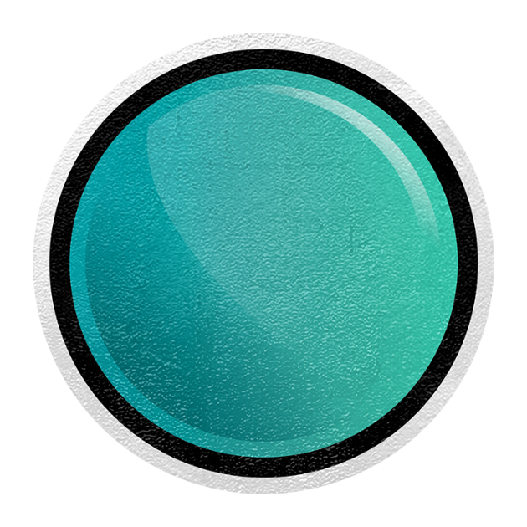




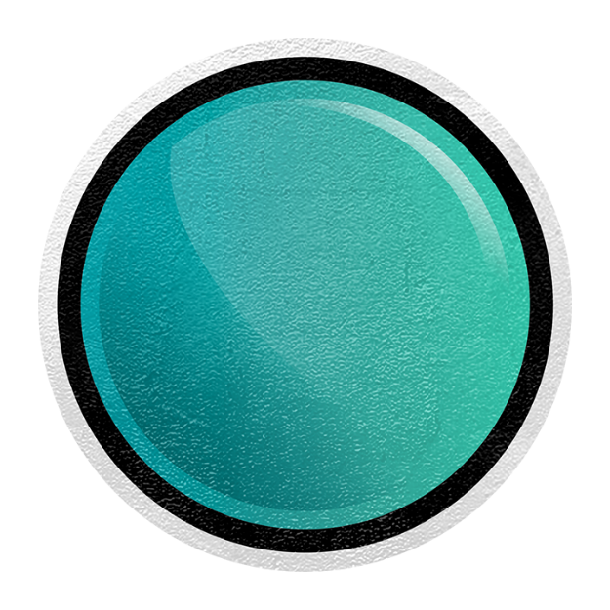


Typy
Aplikací
Tradiční
Monolitické
SaaS
Aplikace
Distribuované na mikroslužbách
SaaS
Serverles
Hybridní
Notes:
Aktuálne app. je možné prevádzkovať v podstate kdekoľvek. Ale čo je dôležitejšie dnes nemusíte prese vedieť kam sa vaša app. alebo dokonca časti vašej app. presťahujú za rok, dva.
Môžete namietať, že tu predsa stále sú a budú legacy app. ktoré len tak skoro nevymiznú.
A máte pravdu. O to dôležitejšie je ale vedieť sa s takýmto mixom starých a moderných app. vysporiadať.
Všetci zápasíme s nedostatkom kvalifikovanej pracovnej sily a jej narastajúcej ceny. A toto je niečo čo sa bude len prehlbovať.
Preto prichádzame s riešením jednotnej správy, ktoré má pozitívny dopad nielen na investície ale aj na prevádzkové náklady vrátane tých na ľudské zdroje.
Ciel je jednoduchý. Zjednodušiť správu takto komplexného prostredia, tak ako sme to dokázali pri infraštruktúre.

Slide 6
Jaké jsou rozdíly
VMs vs Kontajnery
Virtual machines
Kubernetes
cluster
VMs– Virtual machines
Containers - Kubernetes
Notes:
Skôr ako prejdem na riešenia, ktoré Vám VMware vie v oblasti moderných aplikácii, ich tvorby, prevádzky a správy ponúknuť….
Priblížim Vám rozdiel medzi správou virtuálnych strojov a správou kontajnerov.

Slide 7
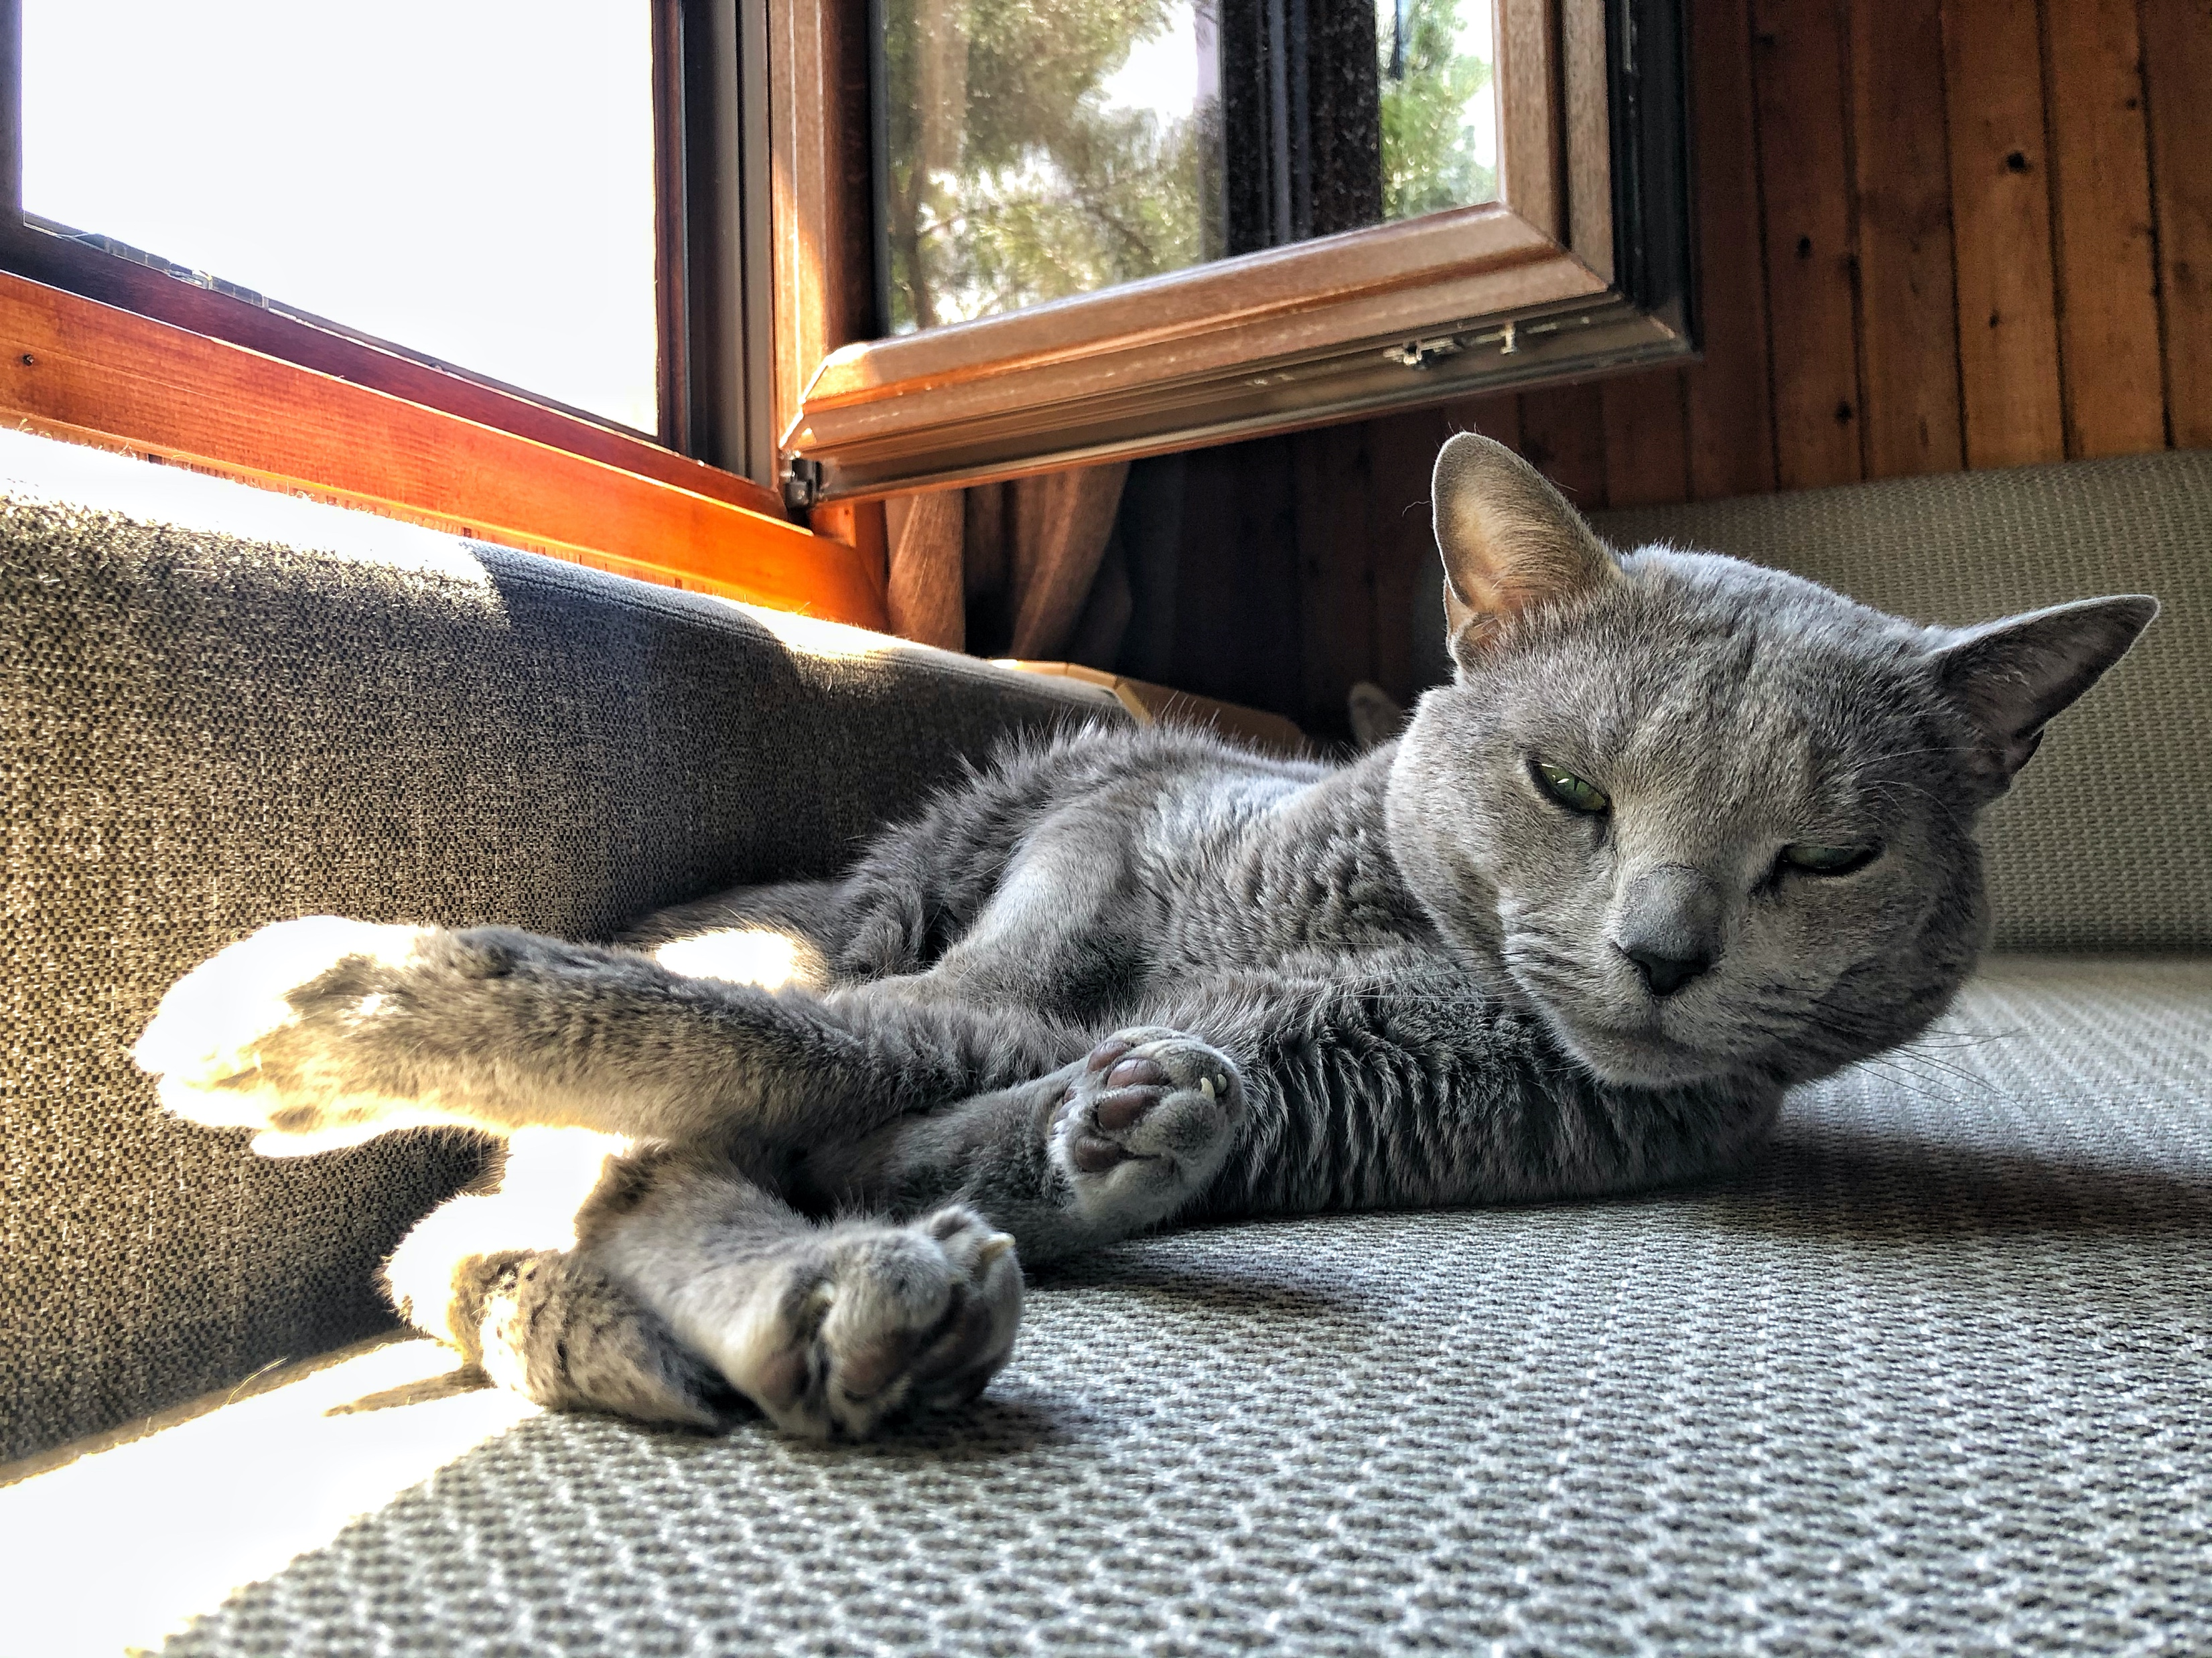
Notes:
Ľudia majú zvyčajne jednu alebo niekoľko mačiek. (klick)
Dávajú im mená, (klick)
vedia, ako sa správajú, starajú sa o ich kŕmenie a o ich ochranu, poznajú ak majú nejaký problém.
Ak zmiznú, hľadajú ich.
Ak zomrú, pociťujú veľkú stratu.
To isté platí pre VM.
Správca VM pozná svoje virtuálne stroje, stará sa o ne.
Vie, koľko ich má, akú veľkosť majú, ako často sa používajú.
vSphere bol postavený na správu veľkých, ale stále v rozsahu tisícov virtuálnych strojov.

Slide 8
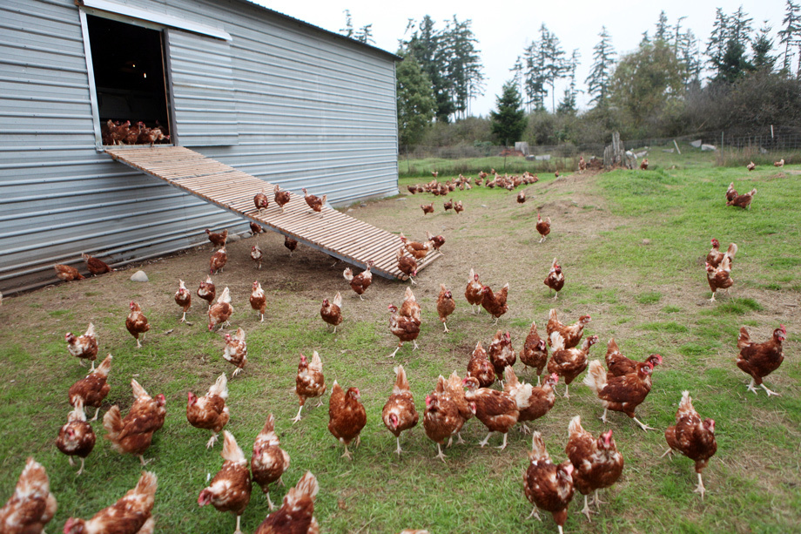
Notes:
V prípade sliepok je to úplne iné…
Máte ich zvyčajne toľko, že im nedávate mená, (klik)
staráte sa o celý kurín a nie o jednotlivé sliepky.
Nemusíte sa starať o každú jednu separátne, nepoznáte ich, na ich správu potrebujete automatizáciu.
Ak niektorá zahynie, žiadny problém, sotva by ste si to všimli.
Staráte sa iba o produkciu vajec / mäsa .
To isté platí aj pre kontajnery.
Kontajnery prichádzajú od 1 000 do stoviek 1 000.
Ak kontajner zomrie, Kubernetes automaticky vytvorí nový.
Kubernetes bol stvorený pre správu a orchestráciu kontajnerov.
Vývojári majú radi kontajnery, pretože je jednoduché ich vytvárať a pracovať s nimi.
Kubernetes sa ukázal ako de facto štandard pre správu a orchestráciu kontajnerov.
Bol vytvorená v Google a je open-source.
VMware sa prispôsobuje tejto realite začlenením Kubernetes do vSphere.
Akvizíciou spoločnosti Heptio sme nielen získali distribúciu Kubernetes (distribúcia: špecifická implementácia open-source Kubernetes od spoločnosti Heptio),
ale aj dvoch z povodnych troch architektov Kubernetes.

Slide 9
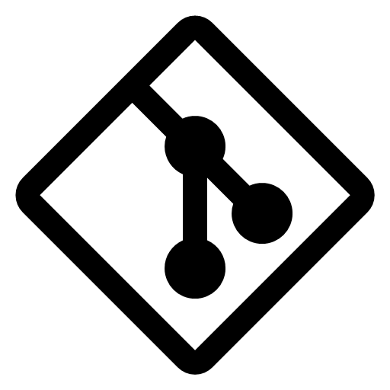

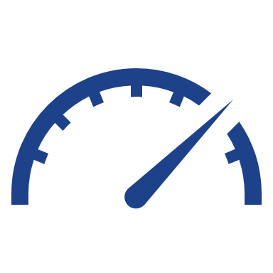




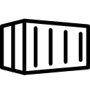
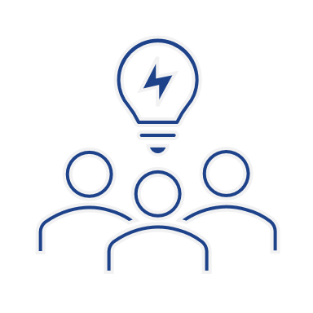


Moderní softwarová výrobní linka
Build Service
K8s Management
Fast
Secure
Scalable
CI
Consistent
Repo
CD
Business Idea
Spring Runtime
K8s Runtime
Service Mesh
End User
App Catalog
Data Services
Monitorring a distribuovaný tracing
Notes:
Service Mesh
Connect, Protect
End-to-end encryption, service discovery

Slide 10
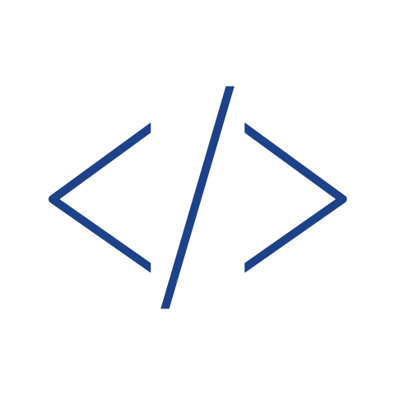
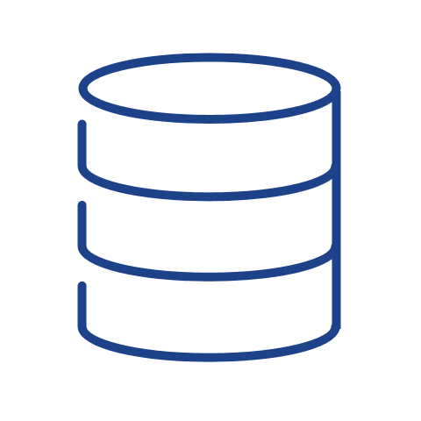
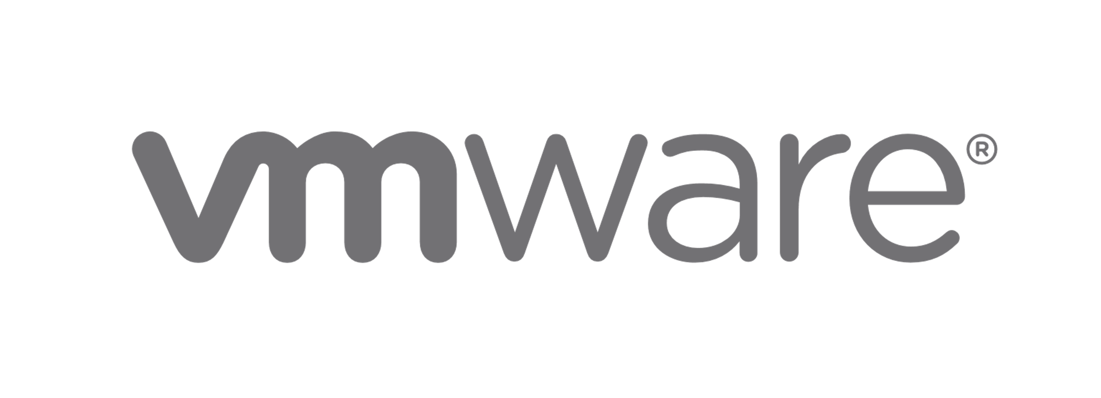
... ale škálování vytváří složitost a chaos.
Více týmů vytváří více operačních modelů
Cloud Native
App Platform
Rozšíření nástrojů, těžko kontrolovatelné náklady
95%
By 2025, cloud native platforms will serve as the foundation for over 95% of new digital initiatives.¹
Těžké sledovat a vynucovat bezpečnost a dodržování předpisů
Platform
Engineering Team
80%
  By 2026, 80% of software engineering organizations will establish platform teams.²
Vědomostní propast nepoužitelné stávající nástroje provozu
1. Source: State of OSS Software Supply Chain 2022, VMware
2. Source: VMware Executive Pulse Survey 2022
3. Source: State of Kubernetes 2022, VMware
Confidential │ © VMware, Inc.
Notes:
Current state / Pain points:
- all companies are software companies. To compete and grow, a business must be great at delivering new apps faster – to do that they are looking to cloud native patterns and technologies
Cloud and containers, open source were quick/easy to get started but have grown out of hand...too many disparate services, different tools, apps/teams, different levels of knowledge using them, adding complexity at scale--- result = creates friction (toil, tickets, manual process), no economies of scale in process/standards/purchasing power and increases risk
- multi-cloud adoption and k8s at scale leads to complexity and increases cognitive overhead for devs (and ops teams that are trying to keep up with the speed of business)
- How do you solve for the complexity, tool sprawl, cloud chaos that comes with distributed, multi-cloud and the cloud native ecosystem?
- How can you streamline your operations to maximize what cloud has to offer?
- What do you need to provide your app dev teams to enable faster, more secure app delivery?
For a platform team audience: you’re responsible for all of these things

Slide 11




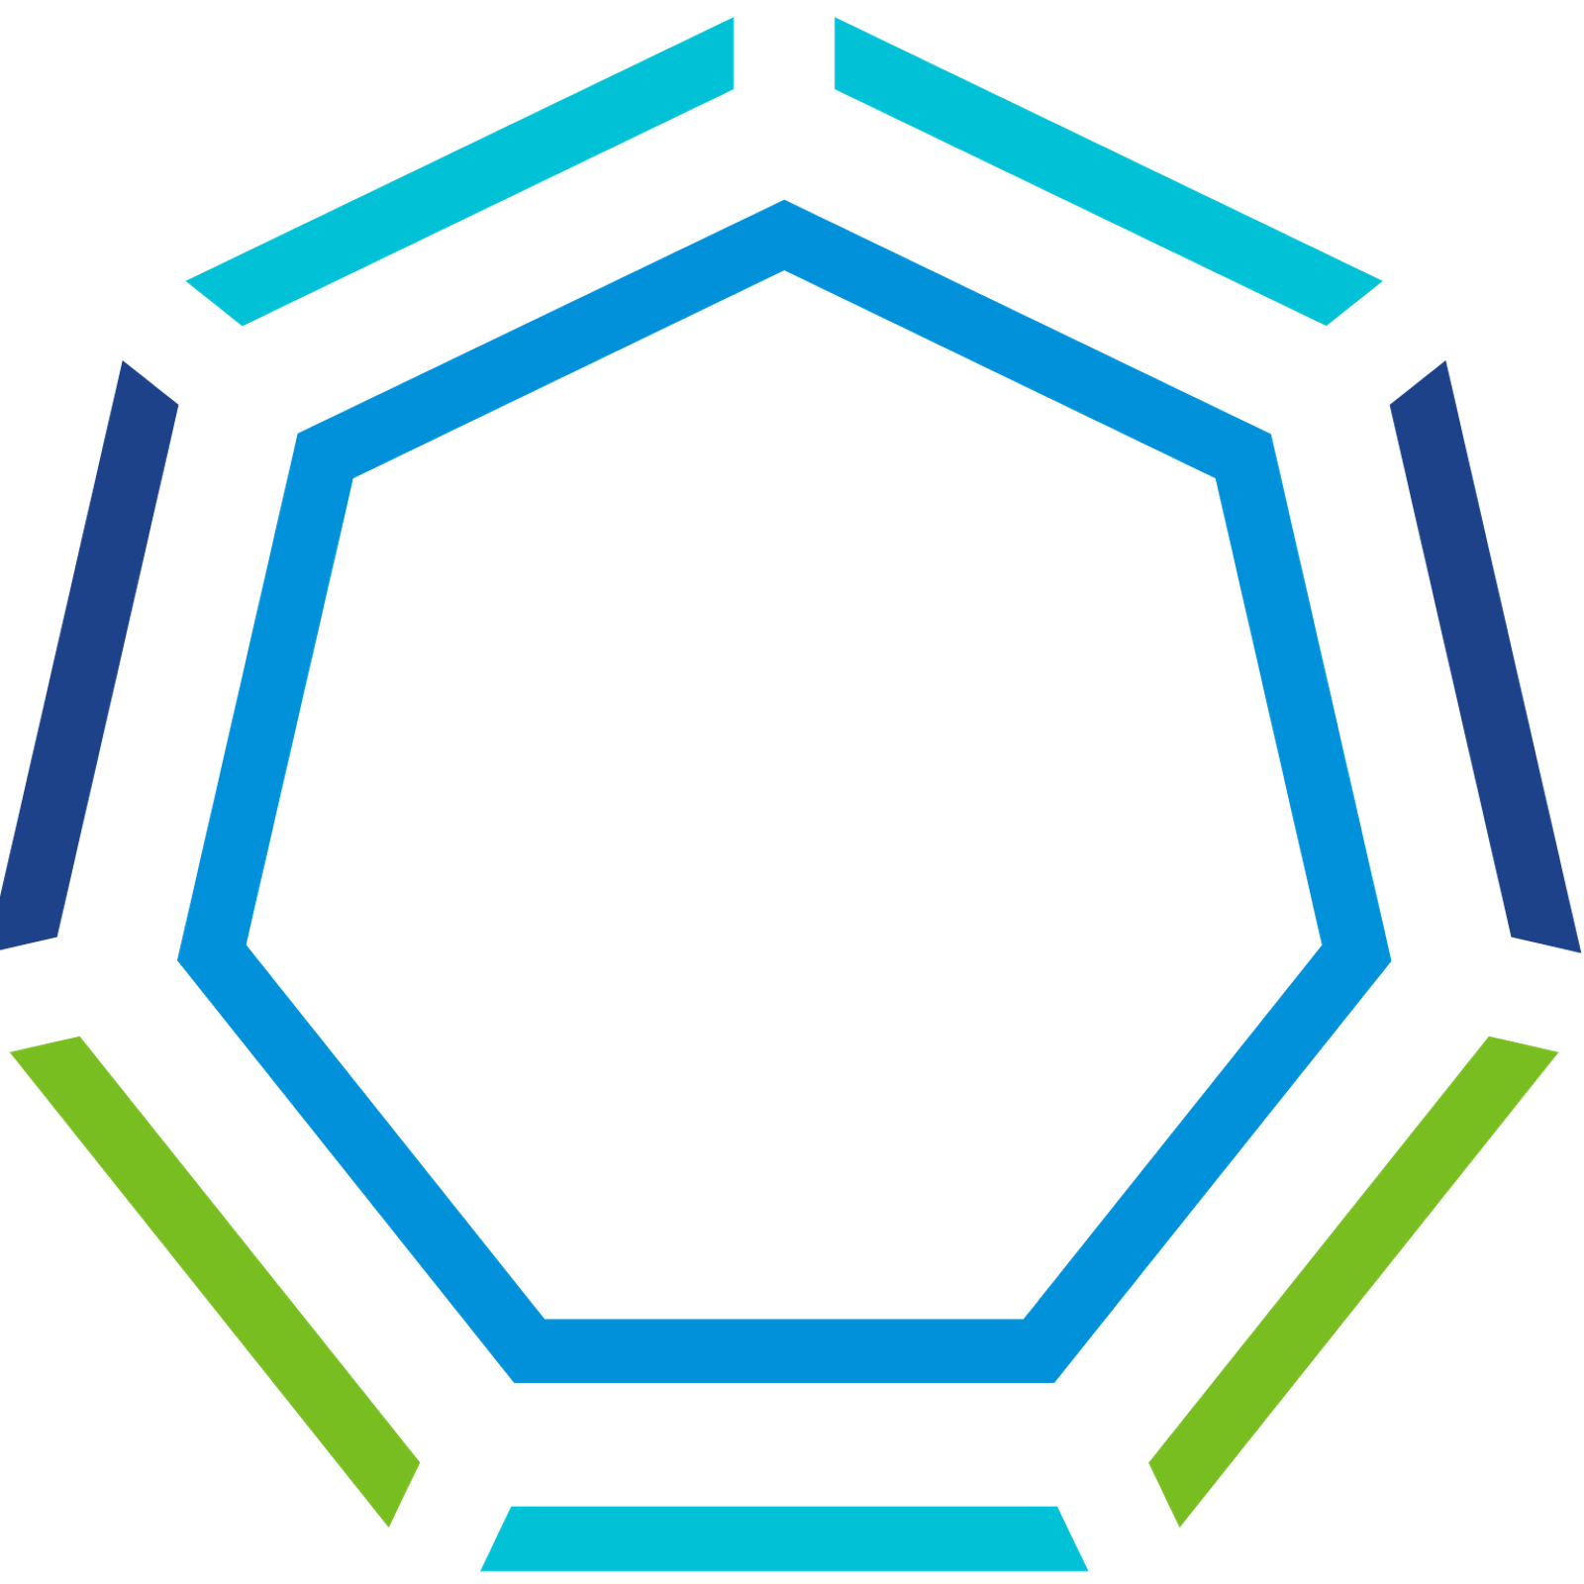
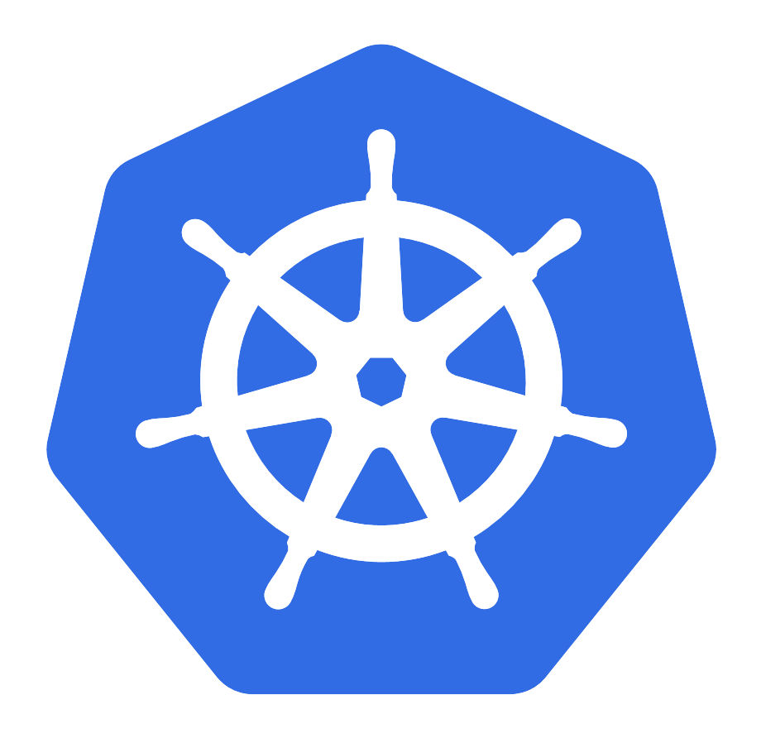



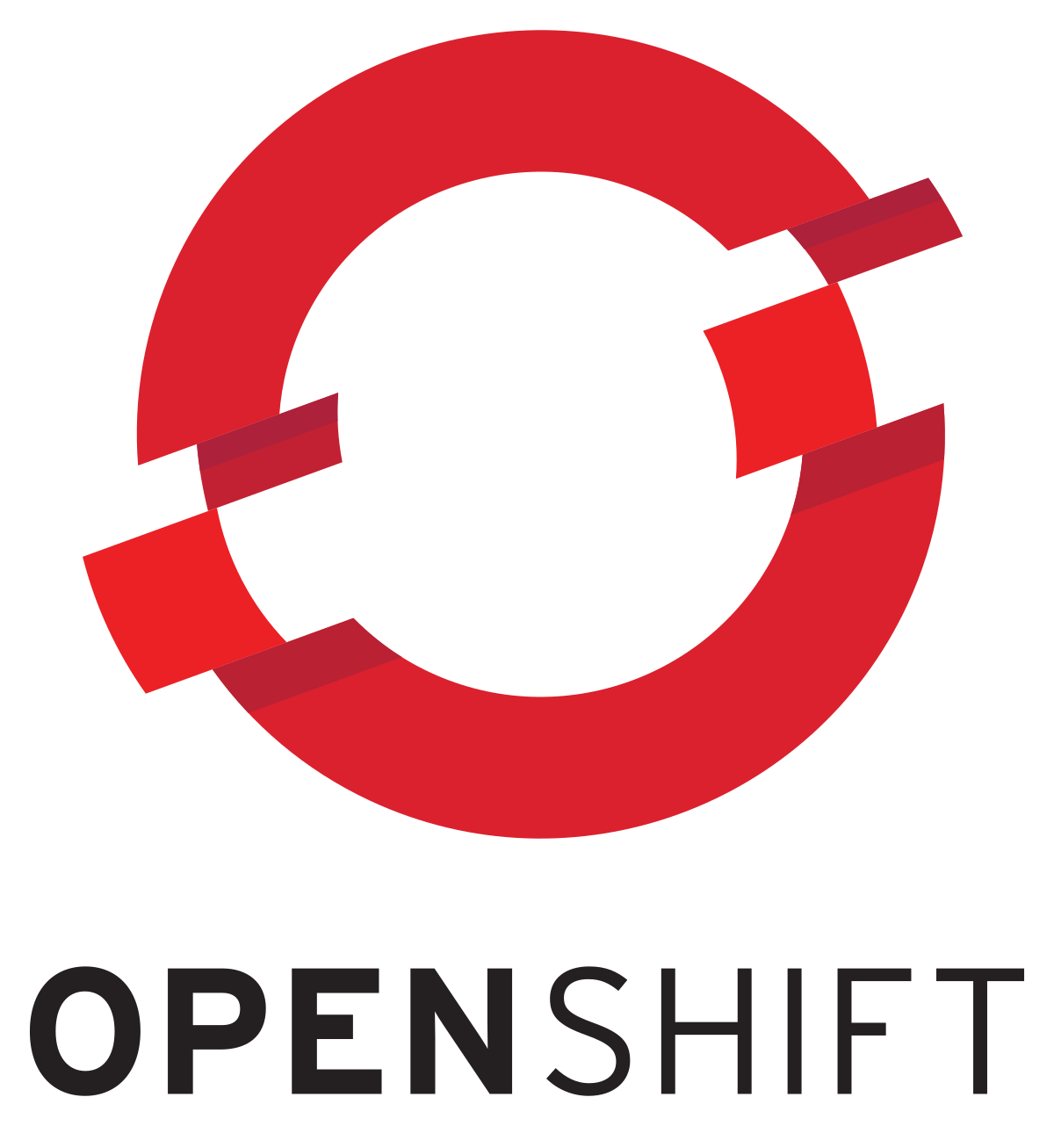
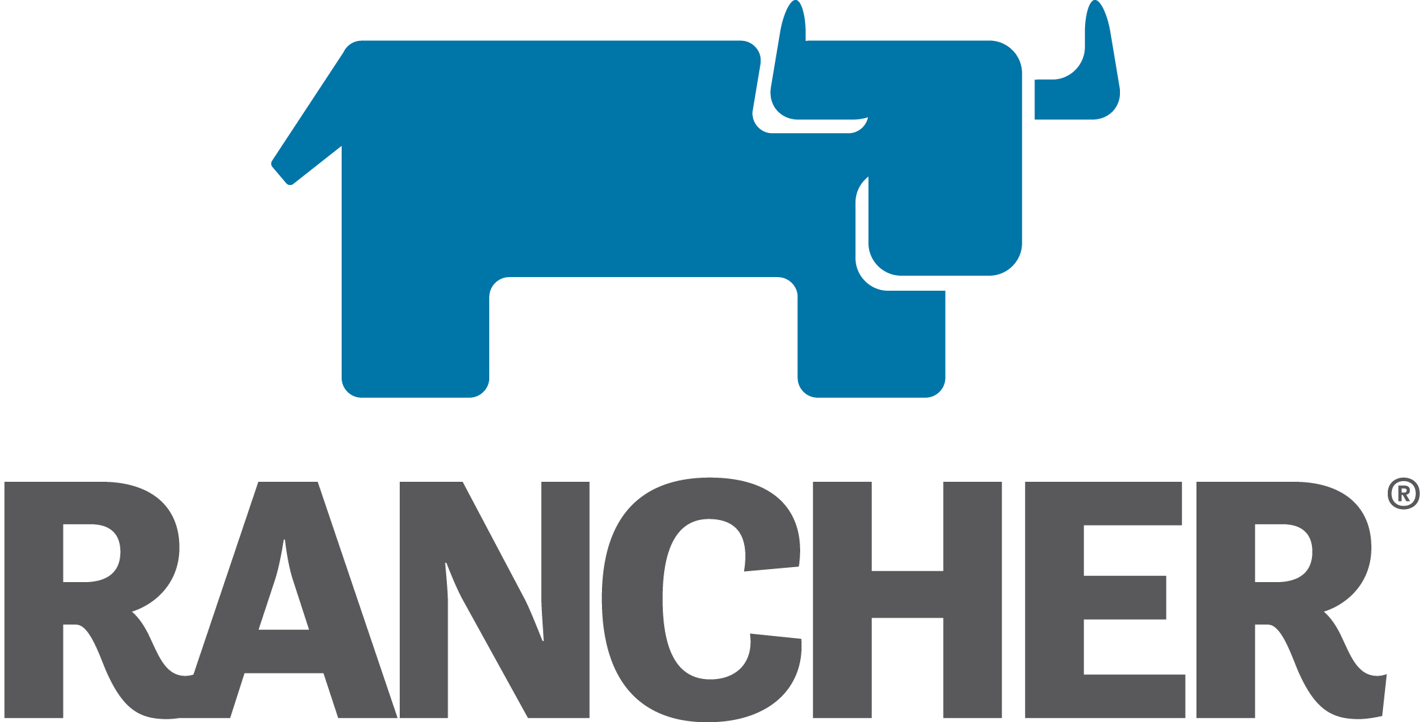
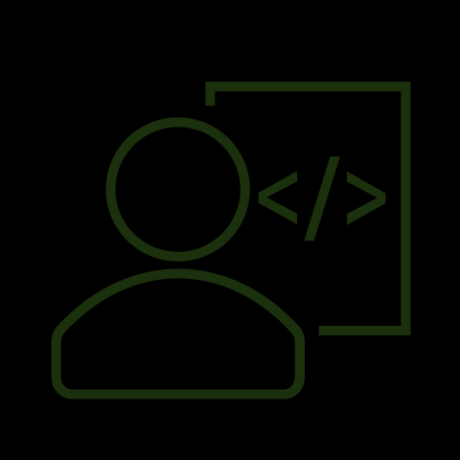
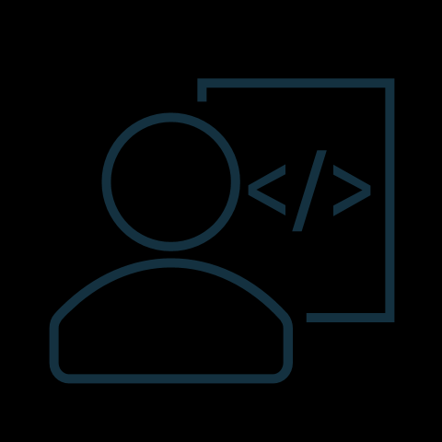
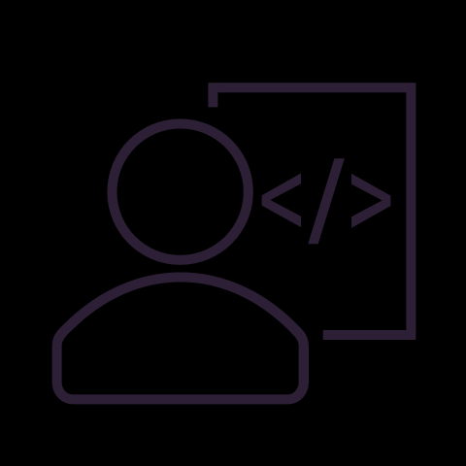
Správa aplikací v privátních a edge cloudech.
Jak to provozovat?
Private Cloud 1
Private Cloud 2
Edge
Notes:
So lets take a look to understand the impact and complexity for Platform Engineering. Developers have broken up once monolithic apps into microservices based workloads running in containers. Every cloud we consume has its own container orchestration solution. And the industry has finally settled on Kubernetes to be that common platform, but every cloud implementation of Kubernetes management and automation looks a little bit different. So these silos have proliferated. <CLICKS> It may have started with a single cluster, perhaps in EKS, but soon resiliency and availability needs meant diversifying among clouds, and distributing across clouds, which meant that now Platform engineers were tasked with managing these resources across multiple public clouds, on-premises and often out to the edge. This is the state that many of VMware's customers are in today.
So the question now becomes - how do we bring consistency to platform operations across a multi-cloud estate?

Slide 12
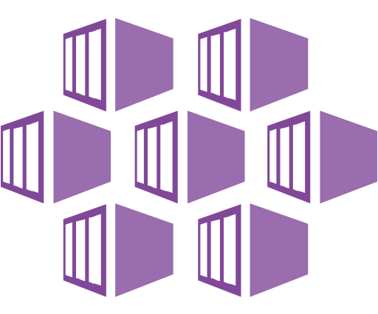
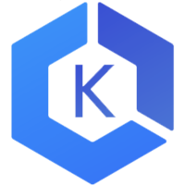
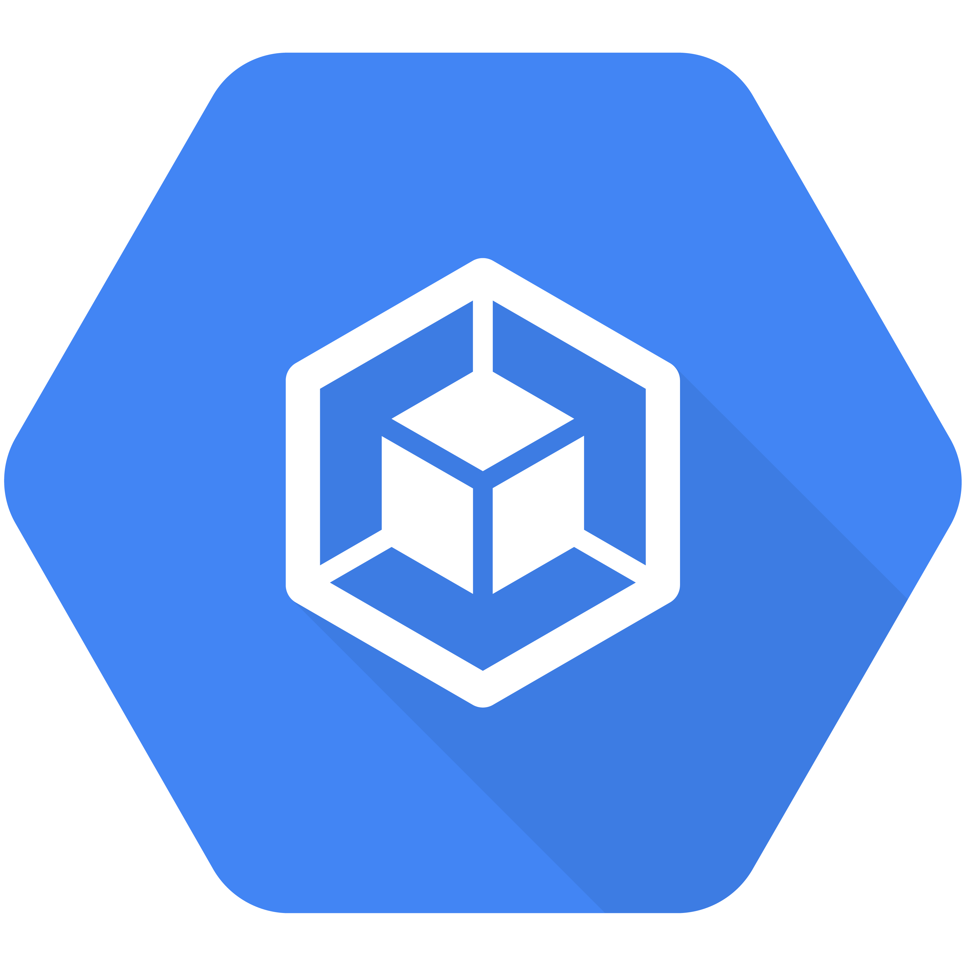
Správa aplikací v privátních a edge cloudech.
Global Control Plane
Private Cloud 1
Private Cloud 2
Edge
Notes:
First this begins with providing a Global Control plane to help drive consistent policy management for security, compliance, and audit requirements, identity and access control, common lifecycle management, and data protection.
A global control plane enables platform engineers to deliver self-service access to the right infrastructure abstractions and services that balance developer choice with appropriate guardrails.

Slide 13
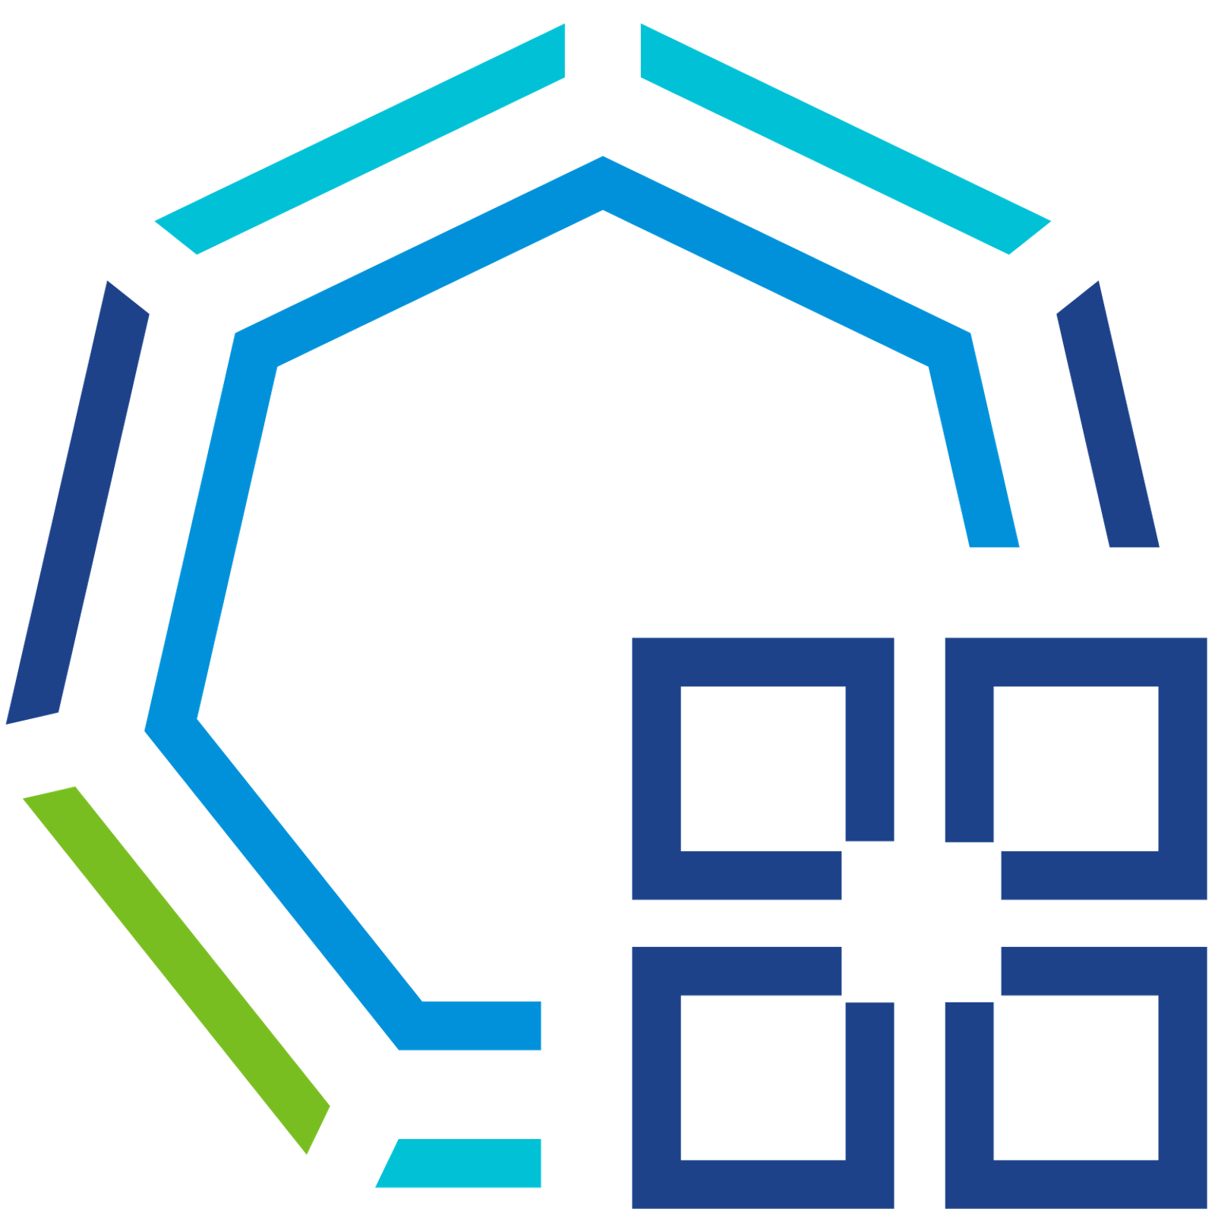
Správa aplikací v privátních a edge cloudech.
Global Control Plane
Private Cloud 1
Private Cloud 2
Edge
Service Mesh
Notes:
As organizations deploy applications across multiple clouds, these applications front-ended by multiple API services that are interacting with each other, processing data, etc. As such it's important to discover what services are open, easily manage certificates, and Encryption from and to these services. A global cross-cloud service mesh should provide API discovery; global identity and certificate management; advanced traffic routing, resiliency, security policies and deep visibility and analytics for all application-level communications. It also should be able to easily visualize Security gaps between multi-cloud traffic flows, detect API threats and PII (Personally Identifiable Information) data.

Slide 14
Správa aplikací v privátních a edge cloudech.
Global Control Plane
Unified Observability
Private Cloud 1
Private Cloud 2
Edge
Service Mesh
Notes:
Finally, many organizations desire to measure the value they’re getting from the platforms and applications powering the business across these clouds and silos. This is where a Unified Observability solution is needed that can provide complete visibility into the applications, platform, and infrastructure resources. Platform Engineers look to troubleshoot effectively, and resolve challenges quickly. They need to effectively measure platform efficiency and business impact of the cloud services they're consuming, and the workloads running on them.

Slide 15


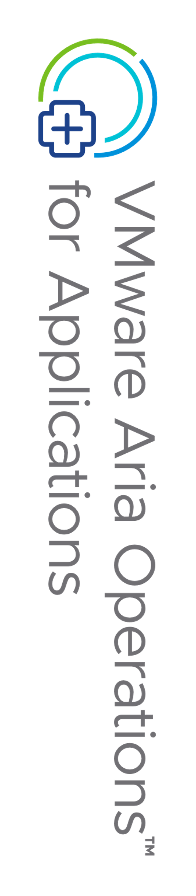
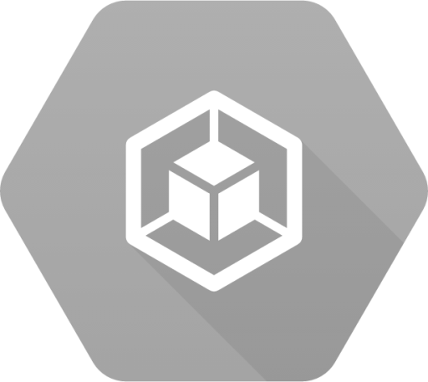



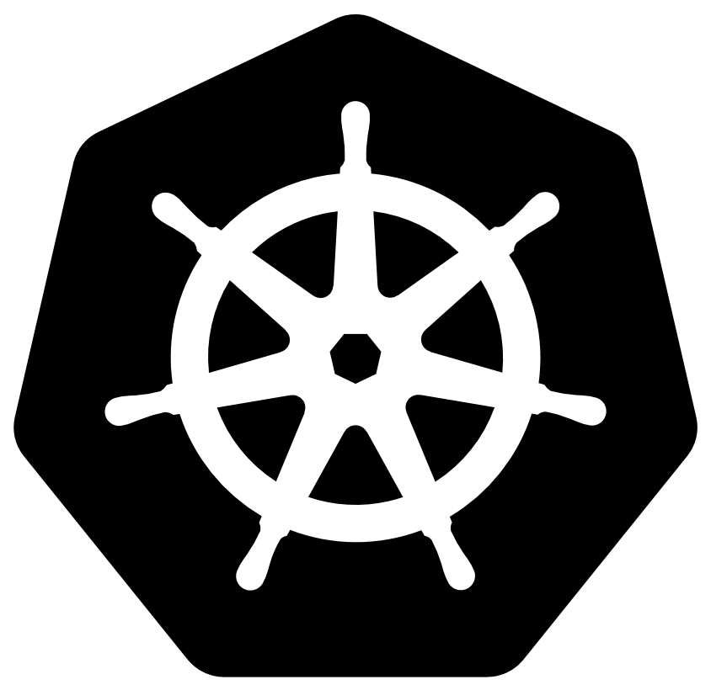
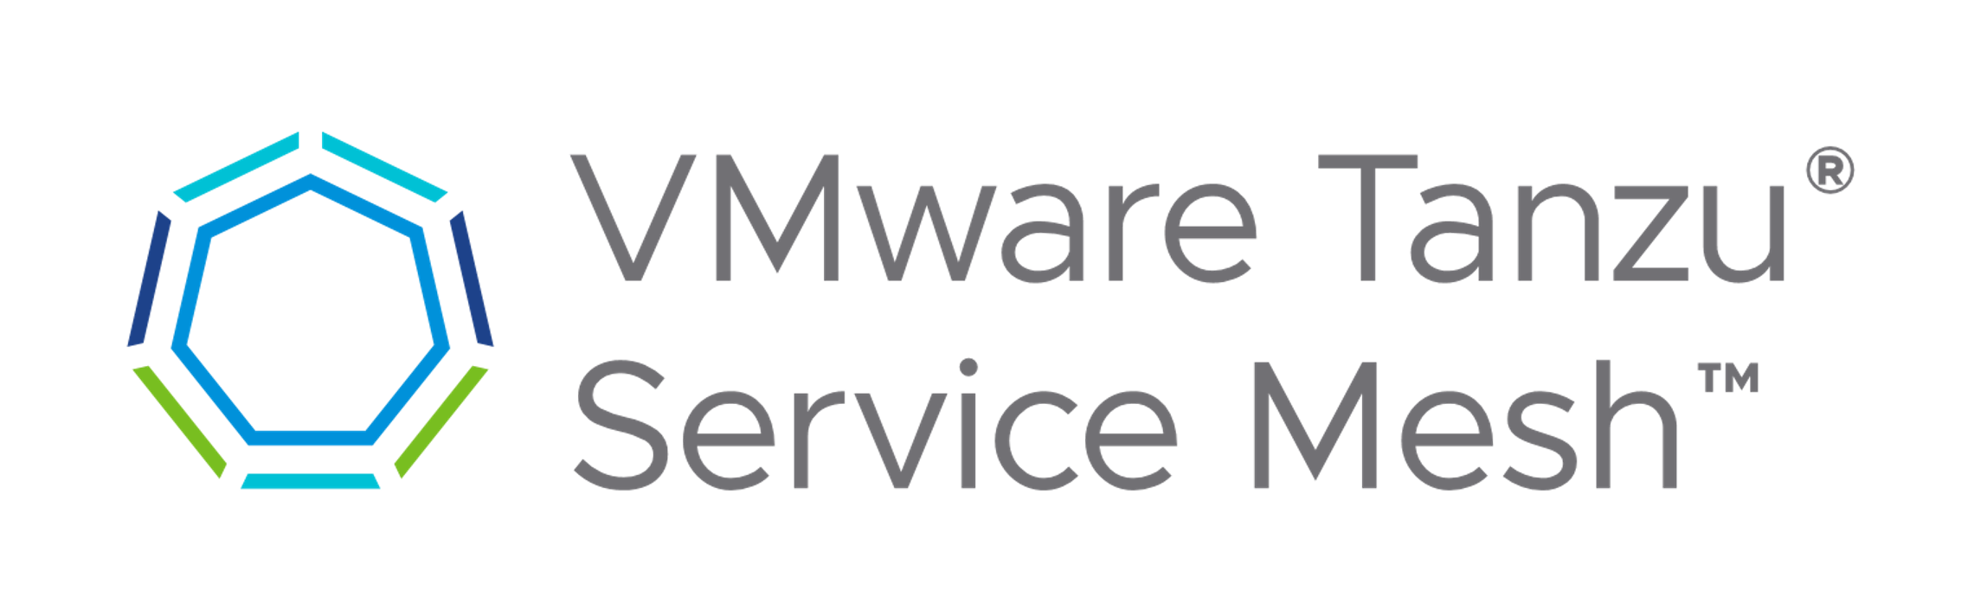
Automatizace operací platformy Kubernetes
with Tanzu for Kubernetes Operations
Fleet-wide Multi-Cluster Management
VMware Tanzu Mission Control
Cluster Lifecycle Management
Policy Management
Data Protection
Application Catalog
Identity and Access Management
Attached Clusters
(no LCM)
Create and Manage Clusters
Private 1 a 2
Metrics | Events | Logging | Traces
Edge
Unified Observability
vSphere
Kubernetes Clusters
EKS
AKS
GKE
OKE
RKE
K8s
EKS
AKS
OCP
TKG
TKG
TKG
TKG
Global Cross-Cloud
Service Mesh
End-to-End Encryption (mTLS)
Global Policy Enforcement
Elasticity and Autoscaling
Service and API
Discovery
Notes:
So How does Tanzu for Kubernetes Operations solve these challenges?
<CLICK> Whether running workloads in managed Kubernetes Clusters in Public or Private clouds, at the Edge or with pre-existing Kubernetes-conformant clusters running anywhere <CLICK> Tanzu Mission Control provides a Global Control Plane for fleet-wide multi-cluster management. Here, we solve the challenge of providing Choice with Guardrails with <CLICK> capabilities that bring consistent management to a multi-cloud Kubernetes estate. Platform engineers can provide a consumption-oriented developer experience while maintaining visibility, enforcing common identity and access controls, and enforcing policy at a global scale.
Scalability and Resilience should be foundational for management of multi-cloud, Kubernetes operations. Containerized applications require data protection policies to look a little different than traditional monolithic workloads; and organizations should implement consistent automation to ensure that back up and restore and cluster restore policies can be applied uniformly across multiple clouds. Similarly, whether you’re a developer building and deploying new applications, or a Platform Engineer who’s managing a K8s platform, you want a stable and extendable approach that provides portability and can adapt rapidly to failures.
Enterprise Security should not be an afterthought <CLICK>, but easy to consume and establish secure, encrypted communications across a global namespace from the moment a service is brought online. VMware Tanzu Service Mesh provides secure mTLS encrypted communications across clouds, can visualize and automatically detect all the services across various Kubernetes footprints, it can help achieve application resiliency by implementing Service-Level Objective (SLO) policies, microservice autoscaling, and multi-cluster and multi-cloud bursting. Tanzu Service Mesh can also bring modern applications insights across application end-users, microservices, APIs, and data enabling compliance with data protection and privacy regulations.
We can bring <CLICK> Operational Efficiency by providing a robust Unified Observability platform with VMware Aria Operations for Applications (formerly Tanzu Observability). This brings together metrics, events, logs and traces from the applications, Kubernetes platforms and Cloud Infrastructure in one place to provide single source of truth visibility and contextualized information for greater business agility while maintaining SLAs. This enables Platform Operators and Engineers to minimize fire drills and disruption, effectively troubleshoot and provide answers as to why something is wrong and how to fix it.
Together, this modular framework brings together the best of the Tanzu portfolio for Automating platform operations at scale. Its important to recognize that in the large Kubernetes landscape, organizations may have adopted different components for capabilities we’ve highlighted here. As such the modularity of the Tanzu for Kubernetes Operations framework should not be overlooked,- in fact we're going to be bringing some pricing and packaging changes later this spring to enhance the value and modularity of Tanzu for Kubernetes Operations - so customers can opt to use preexisting open-source Kubernetes investments in conjunction with our solutions in order to deliver value for their specific use-case and Automate Kubernetes Platform operations.
--------------------------
Characterizing Edge as a cloud – Do we reframe Edge as something that’s not cloud?
ECS - new SKU is more flexible, comp, 50% of edge convos are being led by tanzu field.
Why should they care? - Telco/SASE track, a single session for sales, single ECS session for techincal - core ECS telco technical session (open). likely will need to call attention into it.

Slide 16

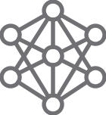
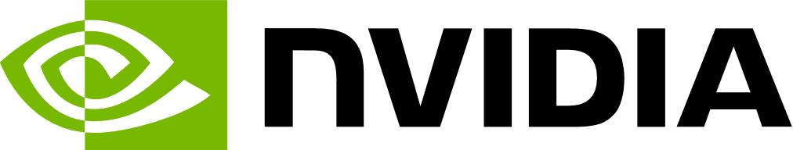
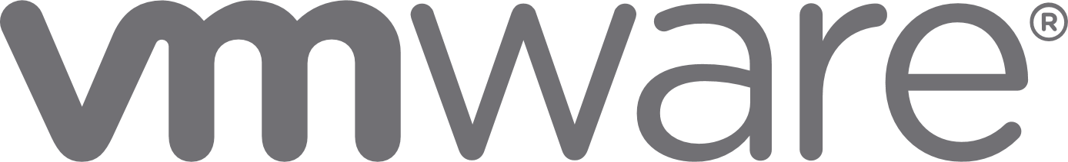

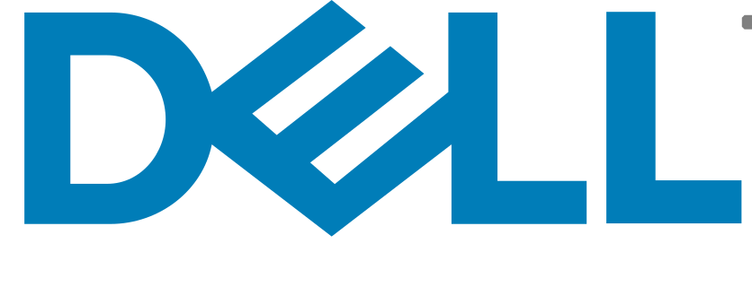

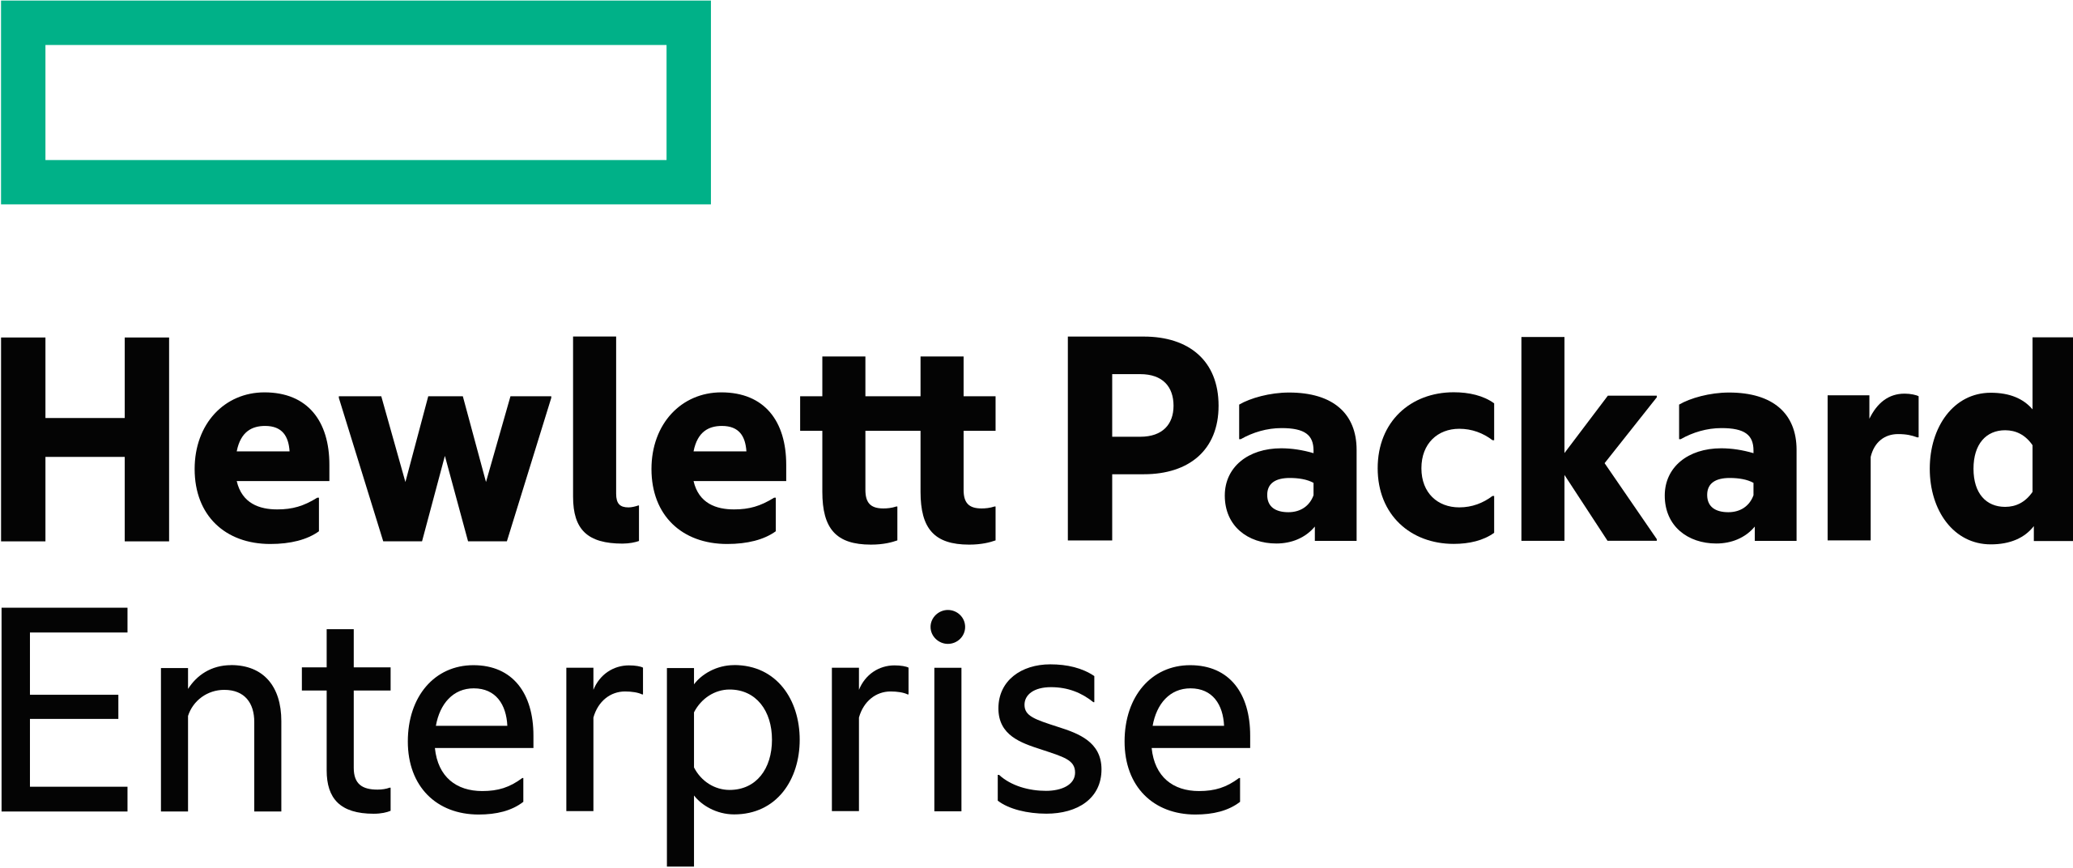
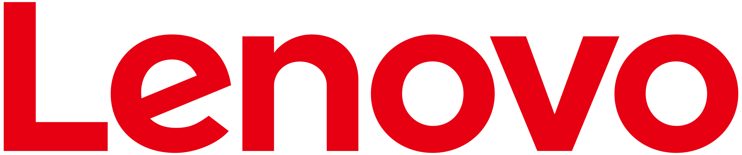
Falcon LLM
Llama 2
MPT
NVIDIA NeMo
INTRODUCING
VMware Private AI Foundation with NVIDIA​
VMware Private AI
NVIDIA
Other options:
AMD
INTEL
NVIDIA AI Workbench
NVIDIA GPU
and Network Operator
NVIDIA NeMo
Framework
NVIDIA Triton Management Service
Deep Learning
VMs
Vector Database
Postgres+ pgVector
GPU Scaling
NVLink / NVSwitch
NVIDIA GPUDirect RDMA
VMware Cloud Foundation
AI Enterprise

Slide 17
Závěr
Zkušenosti našich zákazníků
Bare Metal vs Virtualizace je krok zpátky – nepřináší žádný výkonnostní benefit
Hodně integrací do legacy nástrojů je škodlivé
Prostředky GPU, TPU a jiné je efektivnější sdílet pomocí Hyepervizoru
Nepodceňujte LCM / K8s m8 3x nové verze za rok
Integrace fyzických FW a LB je vždy spojené s nějakým kompromisem
Provoz a Bezpečnost vyžaduje GitOps model
Distribuovaný tracing je nutnost

